Slide 1
Interactive Tiled Display Wall for Exploring Renaissance Paintings
Rieko Kadobayashi
Masaki Chikama
Kaori Fukunaga
Shinji Shimojo
Pragma 17, October 28-30, 2009, Hanoi

Slide 2
Giotto Project
Knowledge Capital Trial 2009 (March, 2009)
  5 Display TDW + Mobile Phone + Flash application
PRAGMA 16 (March, 2009)
  TDW + Mobile Phone UI via Wireless LAN
CEATEC JAPAN 2009 (October, 2009)
  36 LCDs TDW + Mobile Phone UI via Wireless LAN
SC 09 (November, 2009)
  8 LCDs TDW + Mobile Phone UI via the Internet + Live HD Streaming

Slide 3
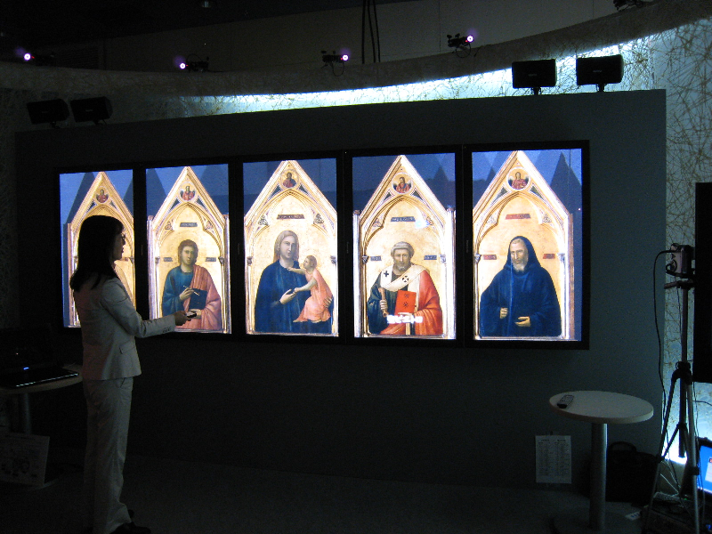

Knowledge Capital (March 2009)

Slide 4
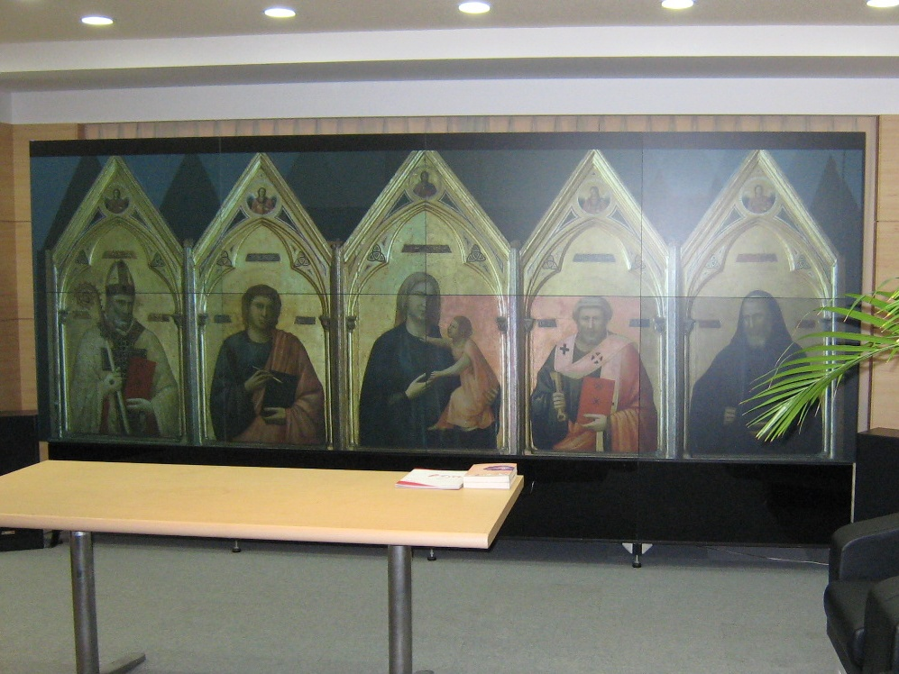
PRAGMA 16 (March 2009)

Slide 5
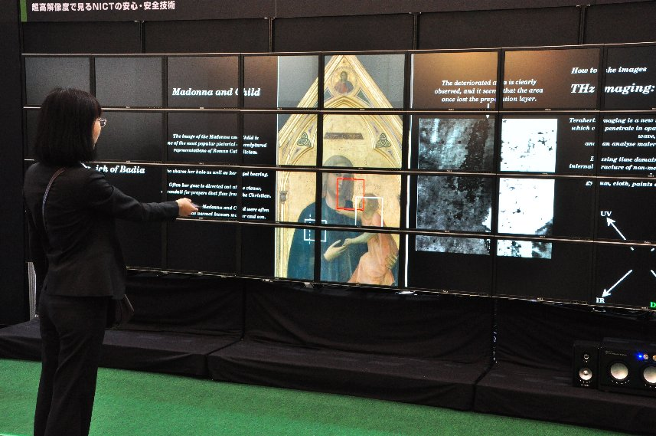
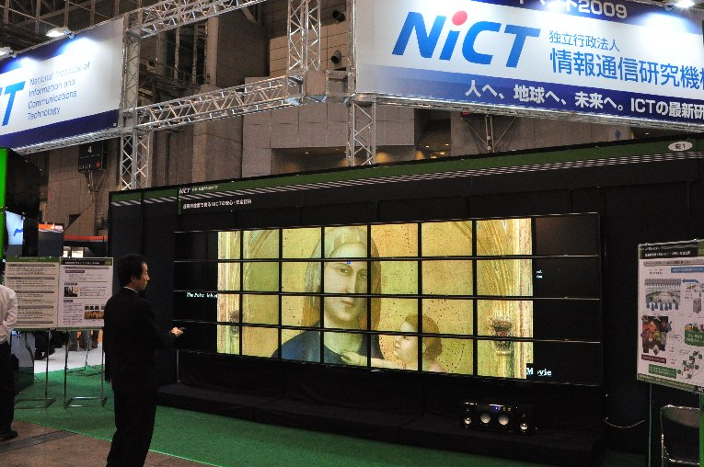
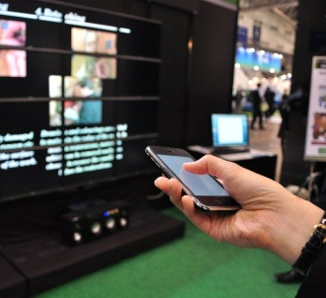
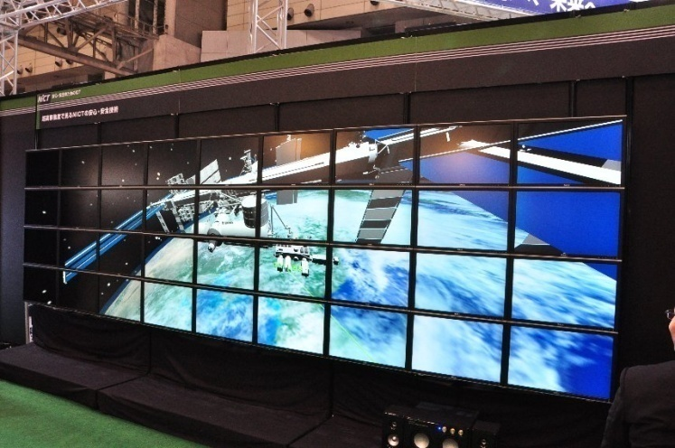
CEATEC JAPAN 2009 (October 2009)
  36 LCDs TDW + Mobile Phone UI via Wireless LAN
  Giotto (images and movies), Space Station (3D models)

Slide 6
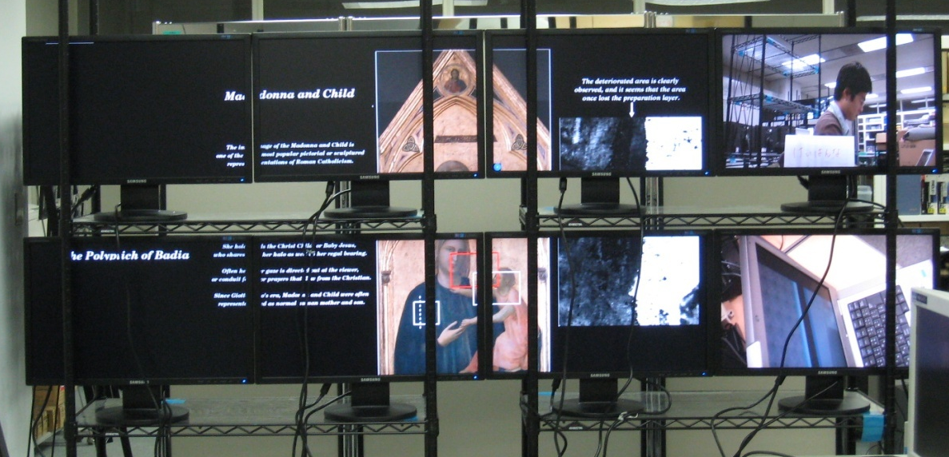
SC 09 (November 2009)

